Slide 1
On the possible detection of C₆₀⁺ in the interstellar medium
Gazinur Galazutdinov
Universidad Católica del Norte
Antofagasta, Chile
Pulkovo Observatory, Russia
Special Astrophysical Observatory, Russia

Slide 2
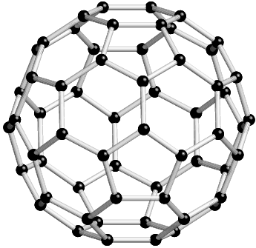
C₆₀⁺

Slide 3
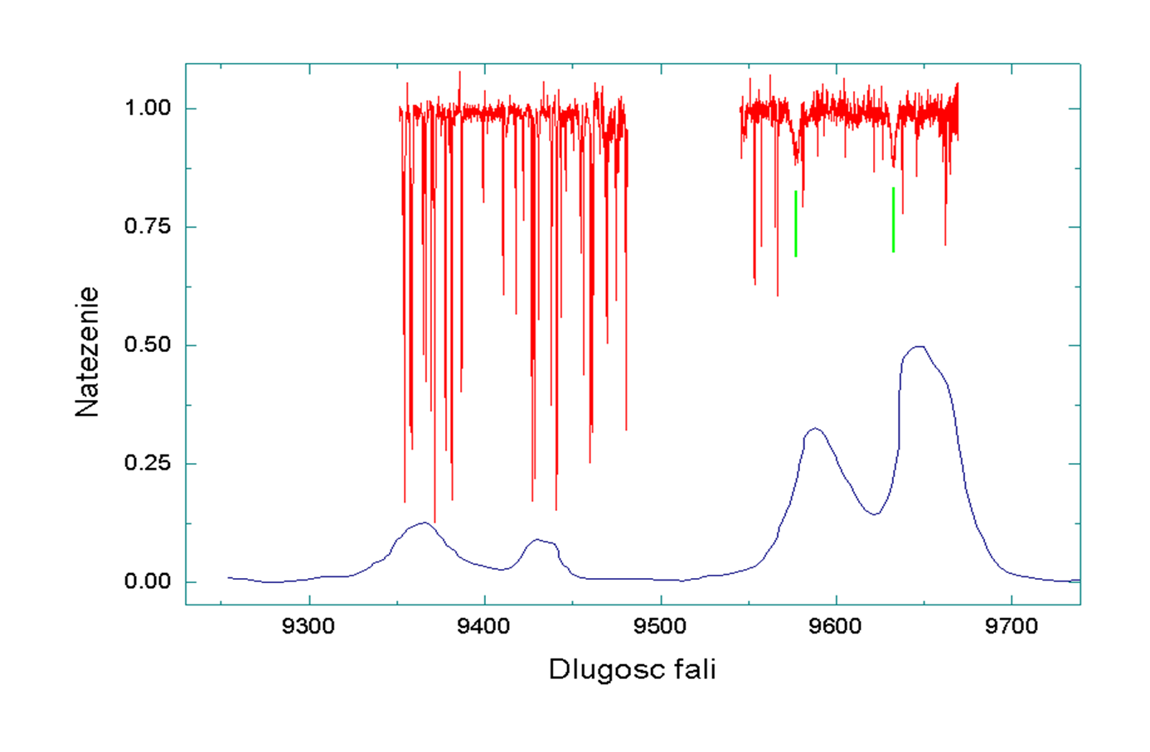
Lab spectrum of C₆₀ cation (blue line) compared to the spectrum of heavily reddened BD +40º 4220 (red line)

Slide 4
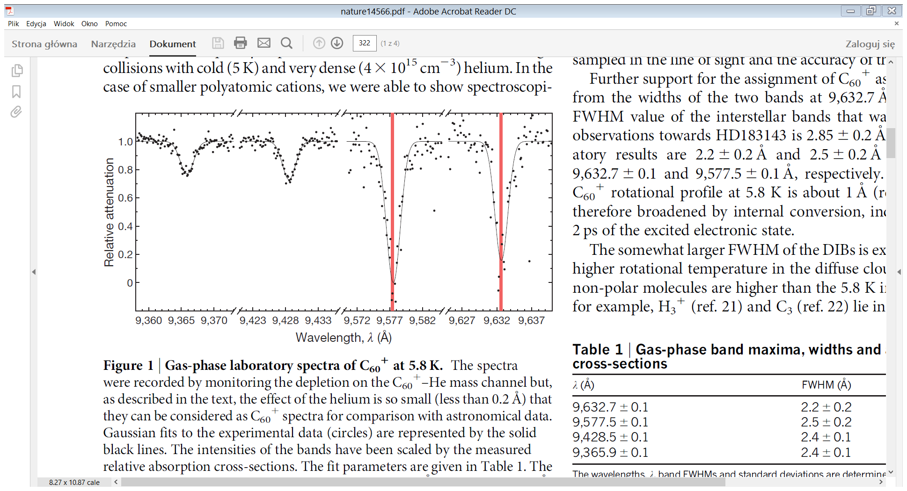
Laboratory gas-phase spectrum of C₆₀⁺ by J.P. Maier & Co

Slide 5
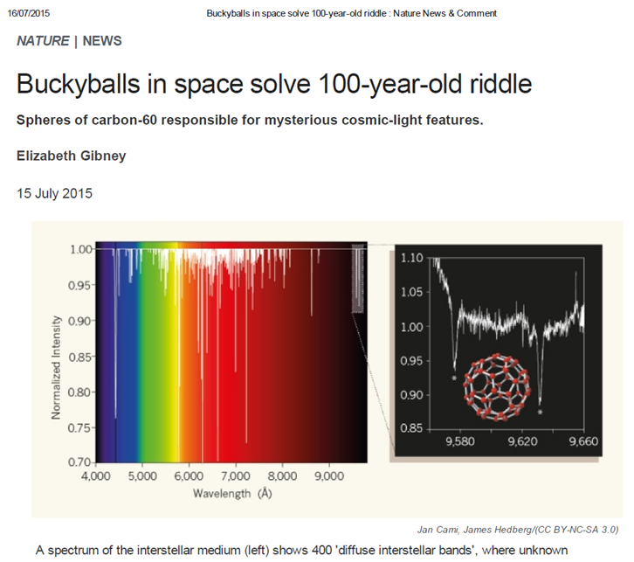

Slide 6
- telluric lines
- stellar MgII blend

Slide 7
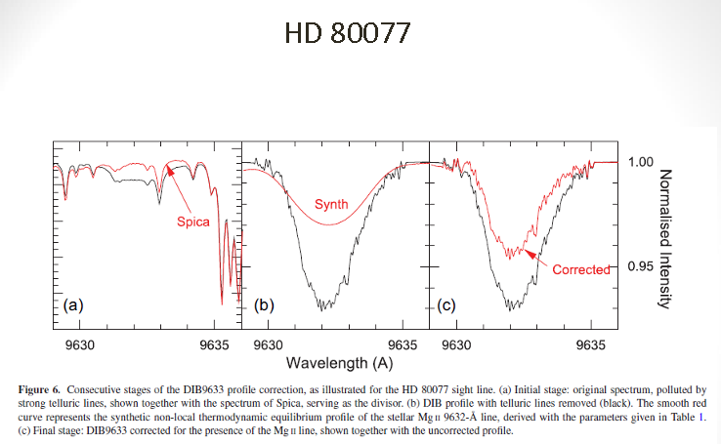

Slide 8
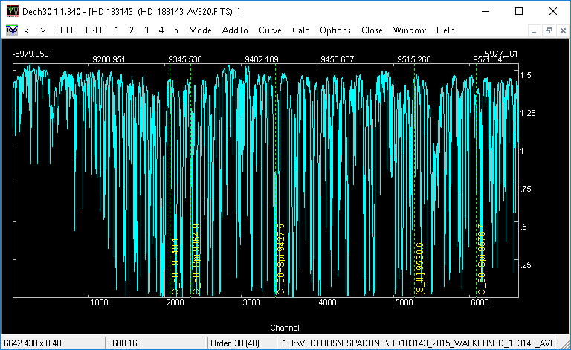
Telluric lines

Slide 9
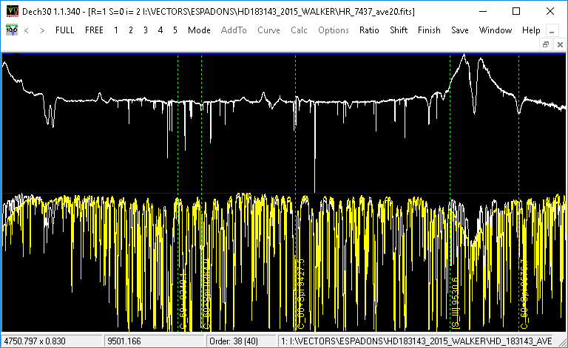
Telluric lines

Slide 10
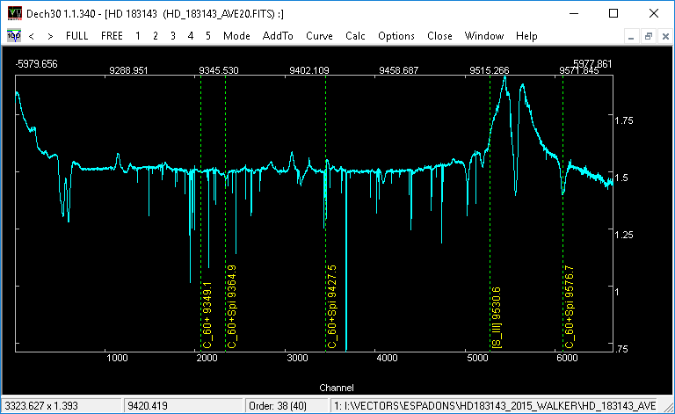
Telluric lines

Slide 11
Galazutdinov, G. A.; Shimansky, V. V.; Bondar, A.; Valyavin, G.; Krełowski, J.
2017, MNRAS, 465, 3956

Slide 12
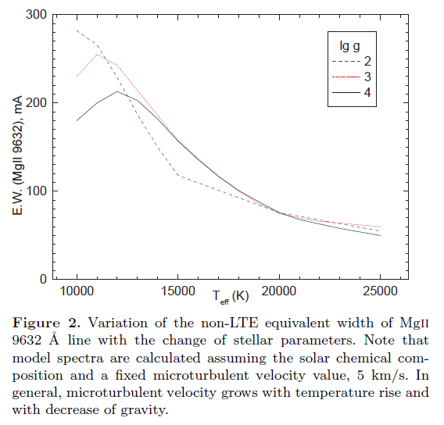
Non-LTE Mg II

Slide 13
Non-LTE Mg II

Slide 14
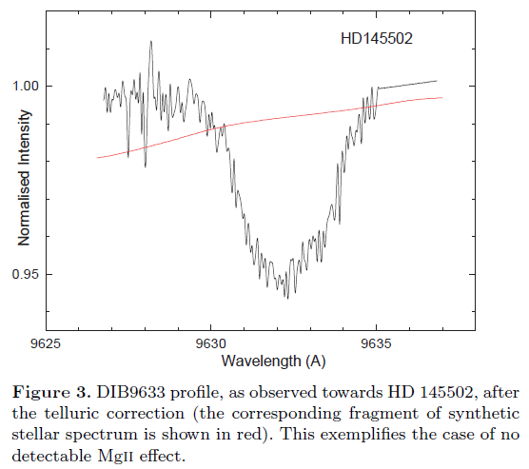

Slide 15
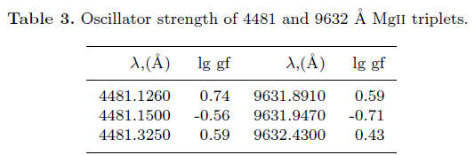
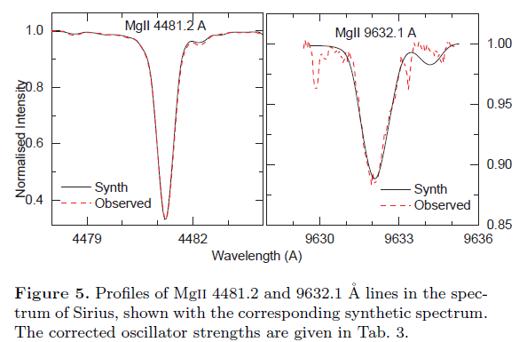
Mg II

Slide 16
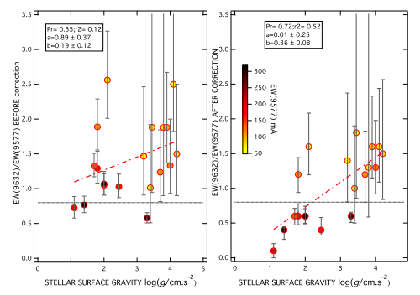
R. Lallement et al., 2018, A&A, 614, A28

Slide 17
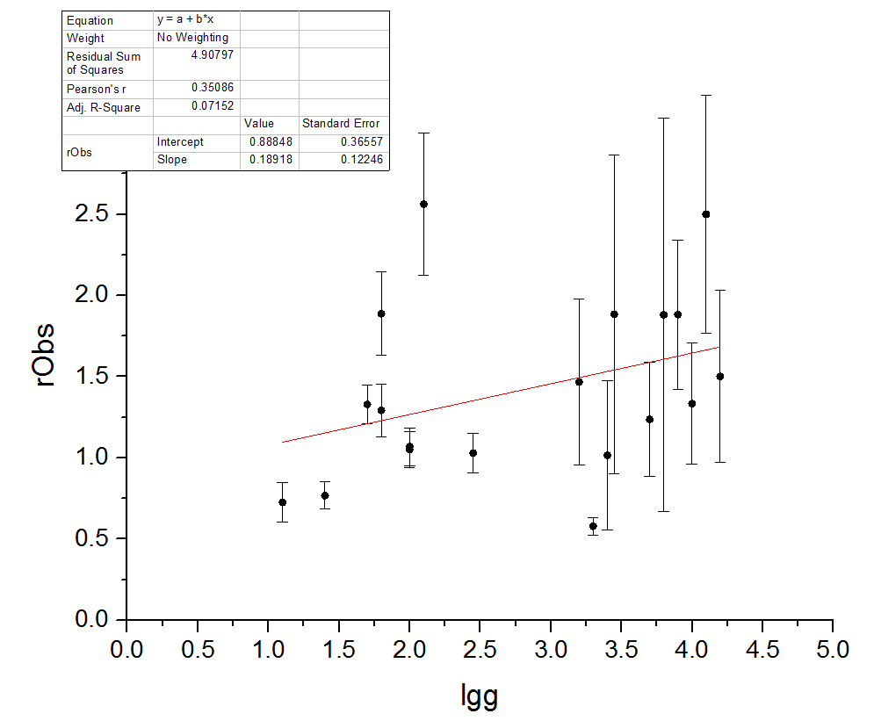
No weights!

Slide 18
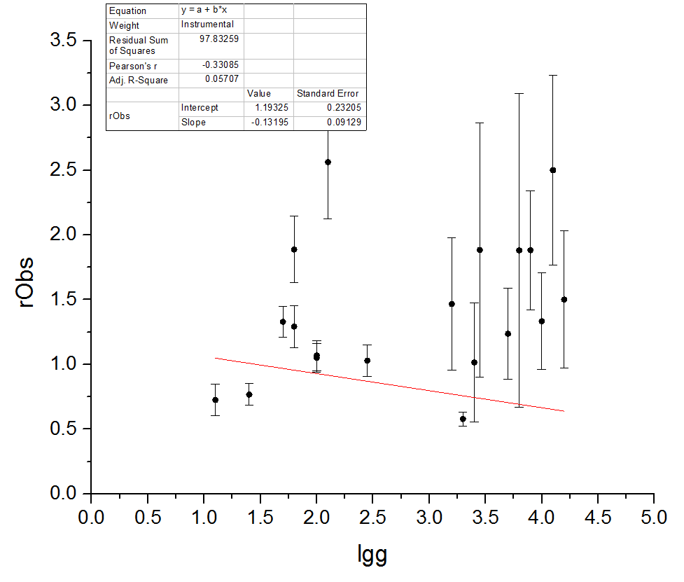
Weighted fit

Slide 19
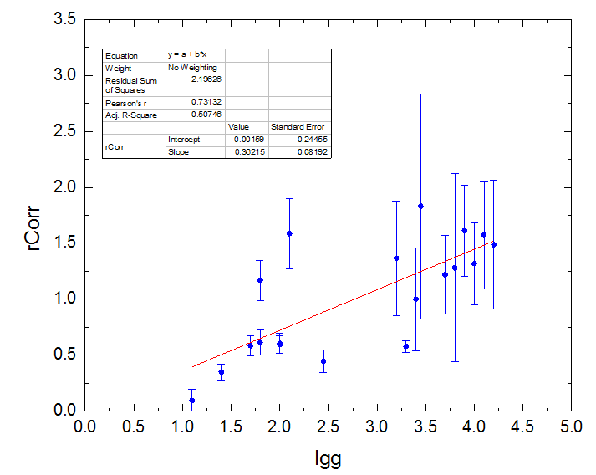
After Correction – No weights

Slide 20
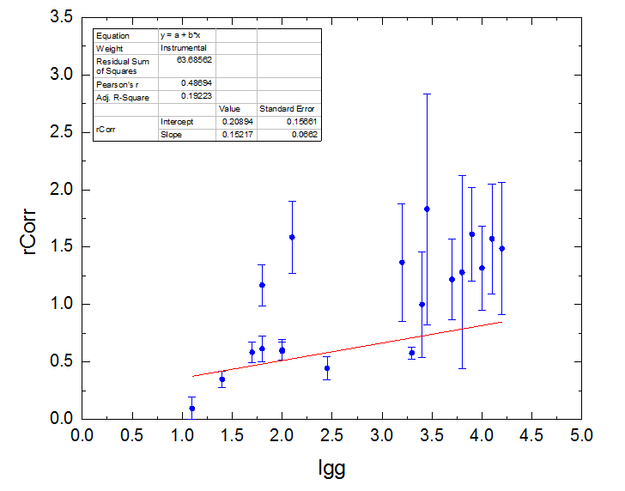
After Correction – Weighted

Slide 21
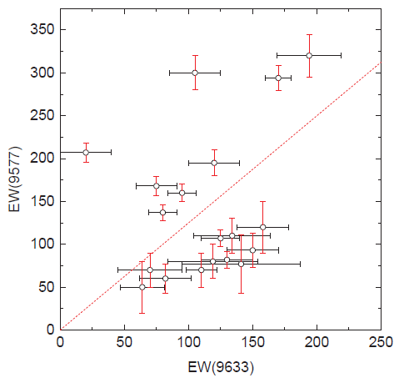

Slide 22
New results

Slide 23
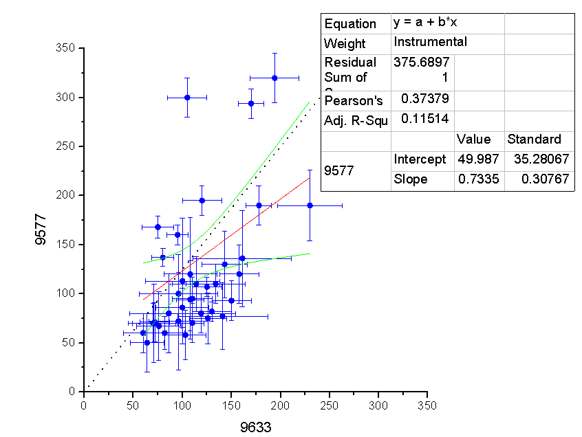

Slide 24
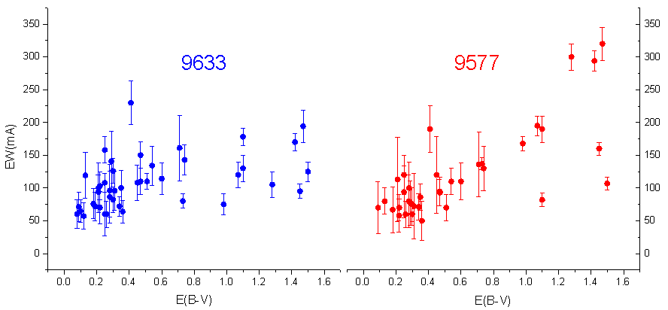
Versus dust

Slide 25
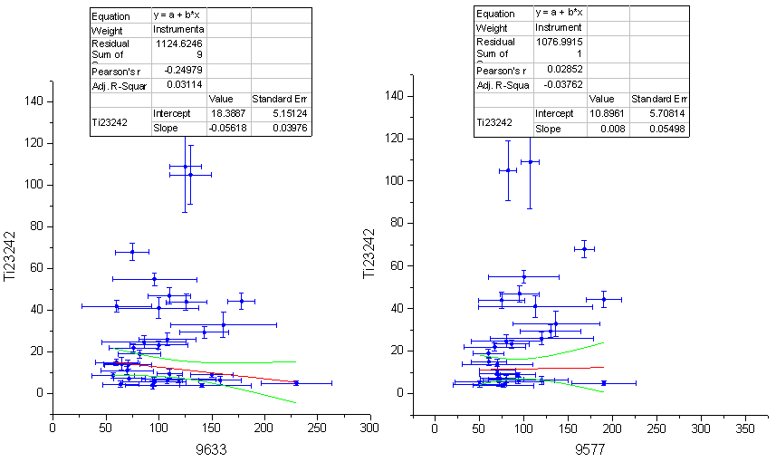
Ti II 3242

Slide 26
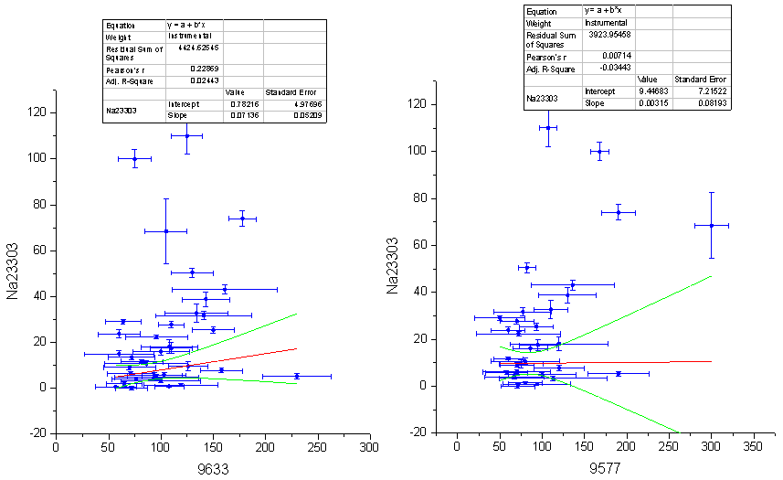
NaI 3303

Slide 27
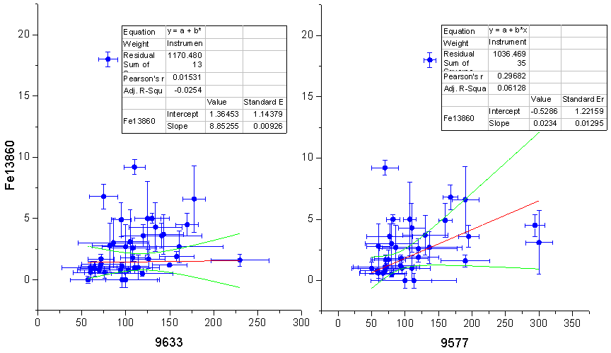
FeI 3860

Slide 28
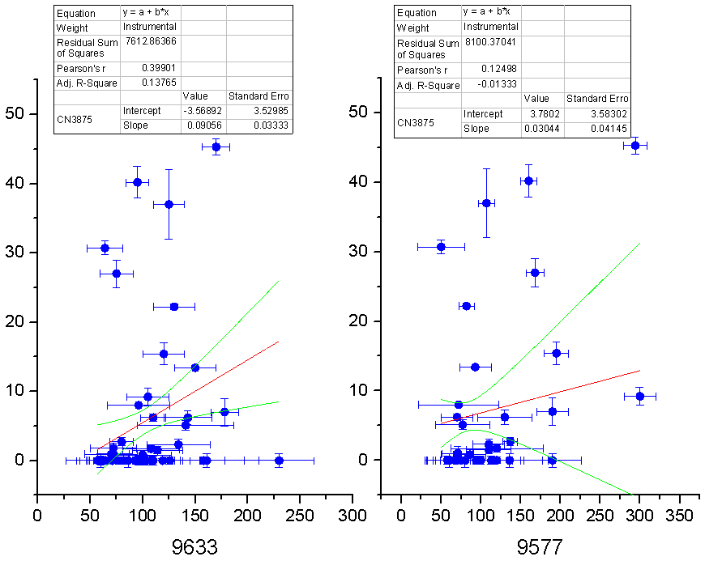
CN 3876

Slide 29
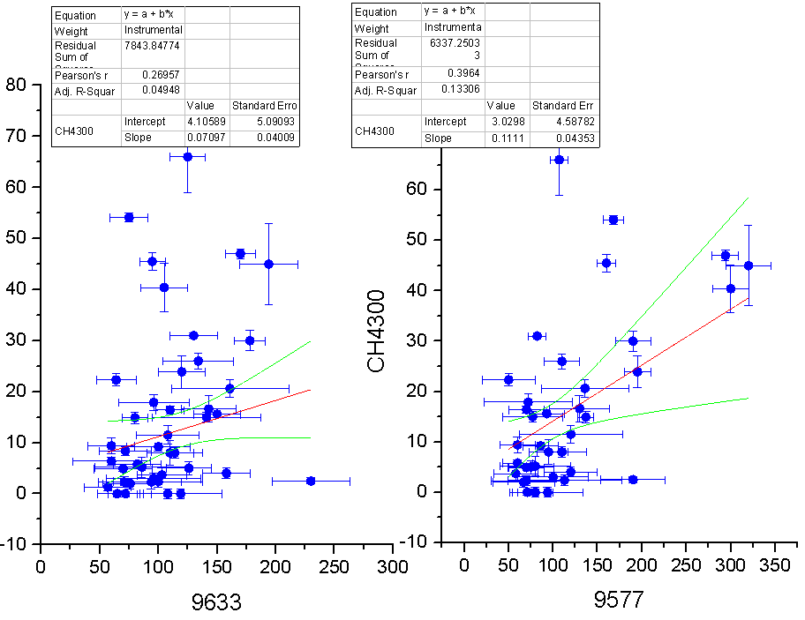
CH 4300

Slide 30
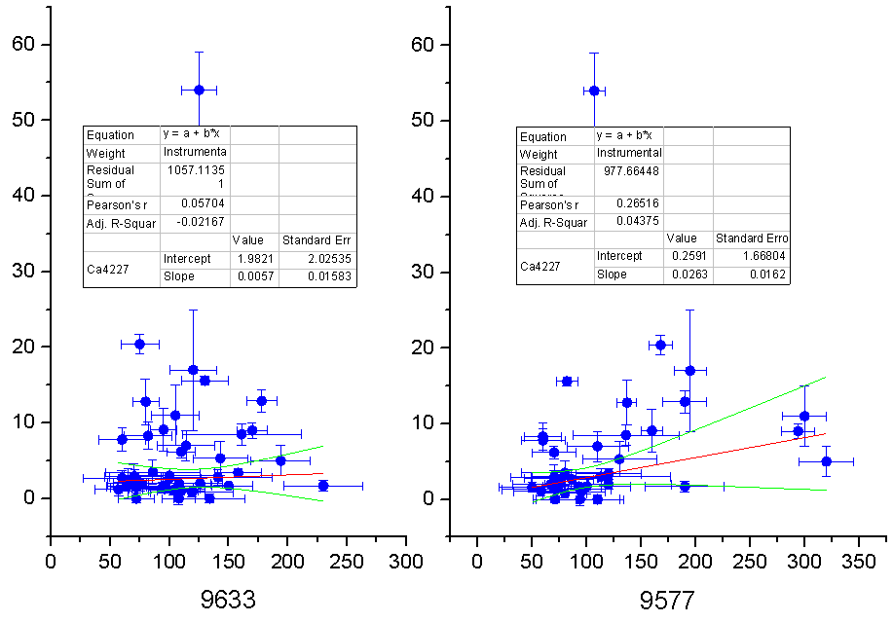
CaI 4227

Slide 31
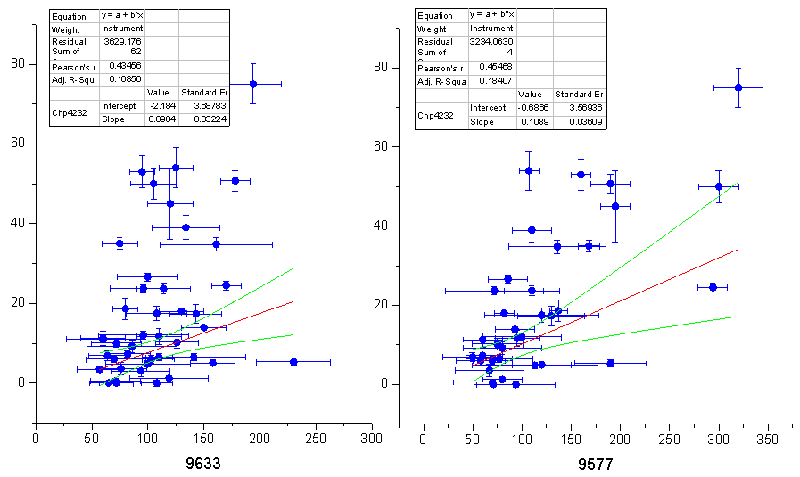
CH+ 4232

Slide 32
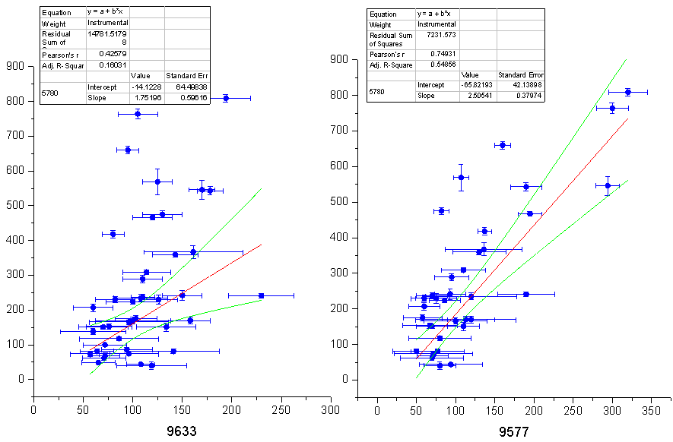
DIB 5780

Slide 33
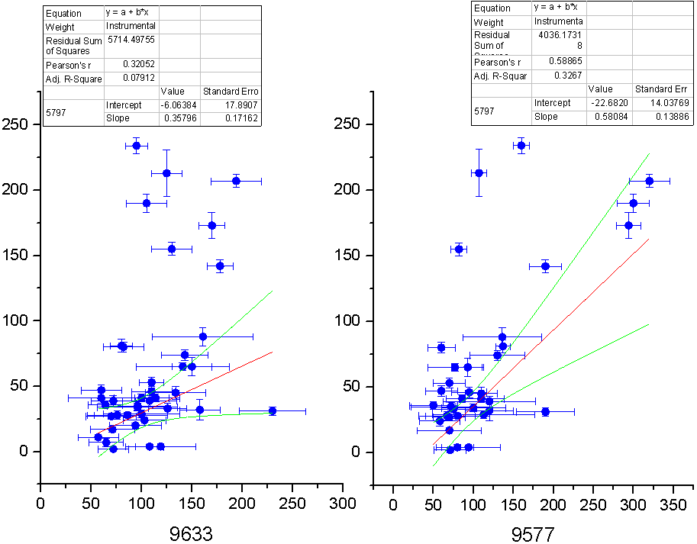
DIB 5797

Slide 34
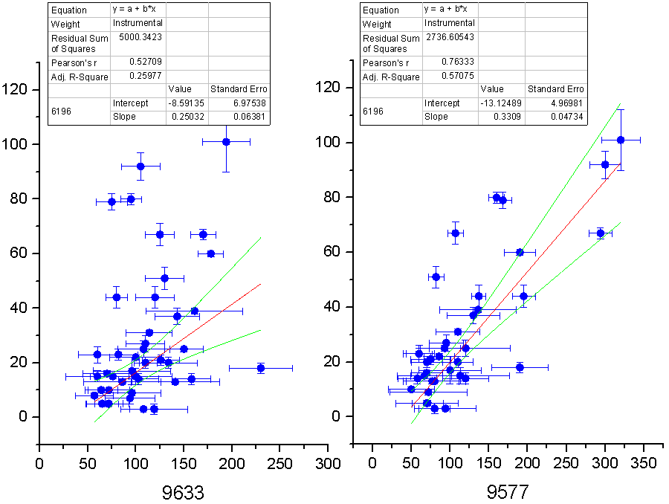
DIB 6196

Slide 35
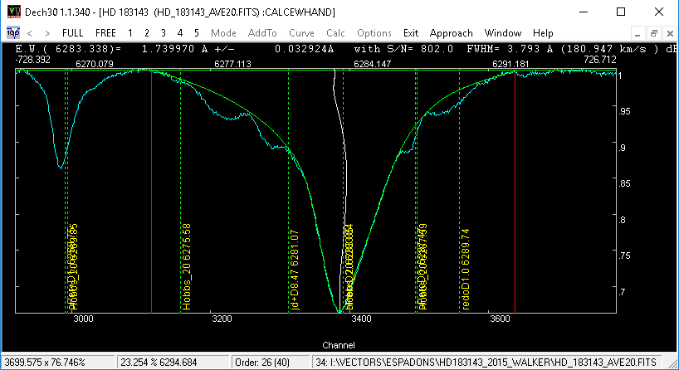
DIB 6284

Slide 36
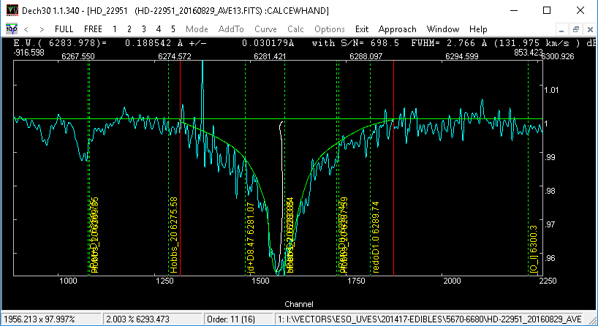
DIB 6284

Slide 37
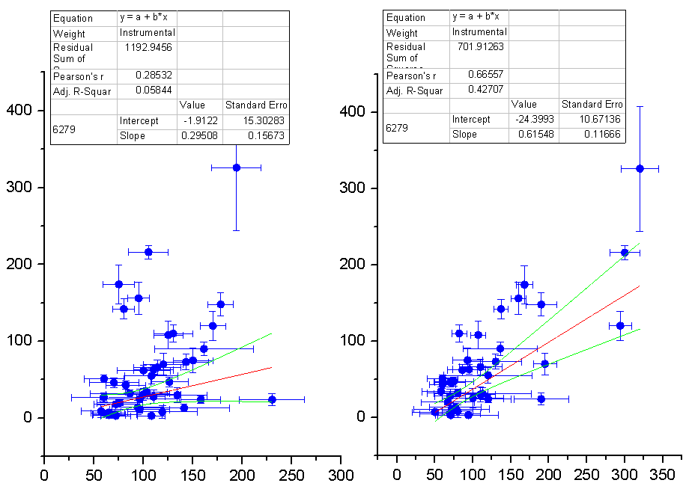
DIB6279

Slide 38
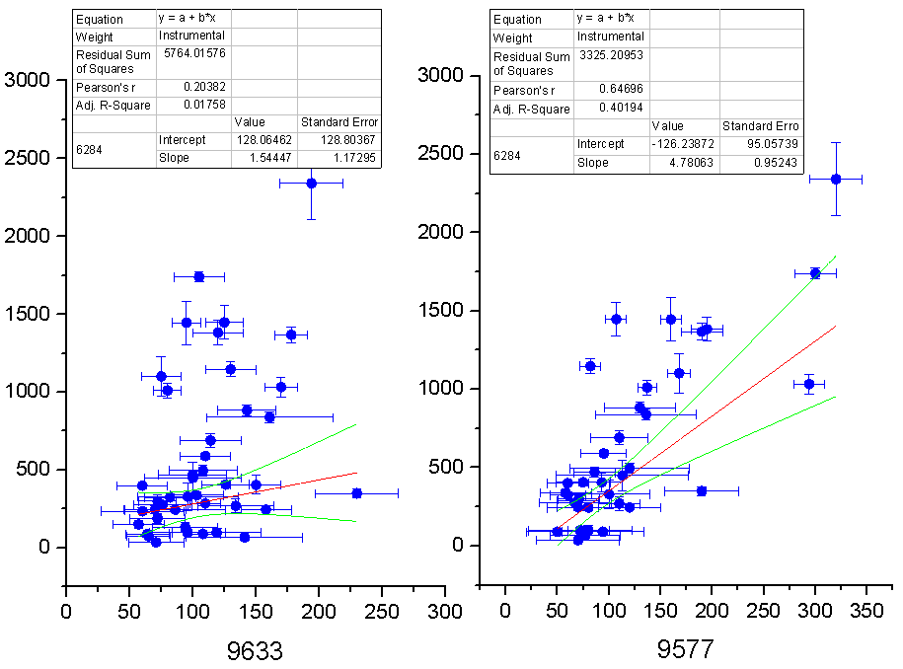
DIB 6284

Slide 39
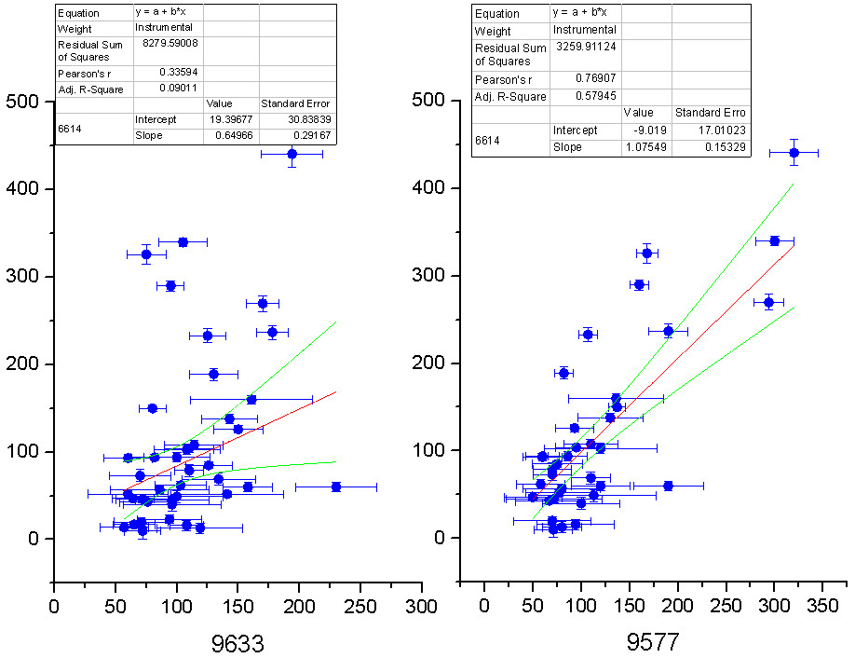
DIB 6614

Slide 40
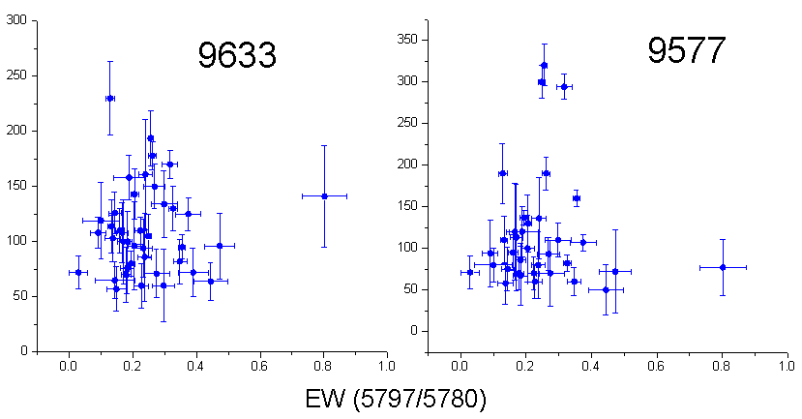

Slide 41
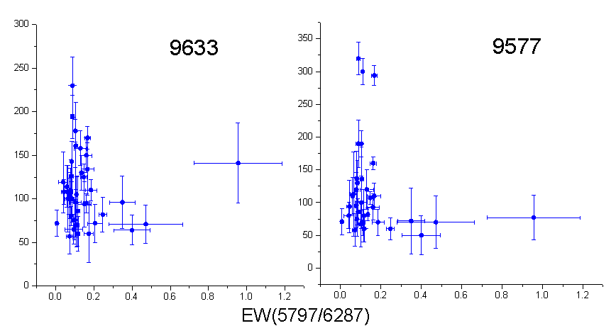

Slide 42
Weaker lines

Slide 43
E.K.Campbell, M.Holz, D.Gerlich, J.P.Maier, Nature, 2015, 523, 7560, 322
9632.7 0.8 9577.5 1.00 9428.5 0.3 9365.9 0.2
E.K.Campbell, J.P.Maier, 2018, ApJ, 858, 36
9632.1 0.84 9577.0 1.00 9427.8 0.17 9365.2 0.26

Slide 44
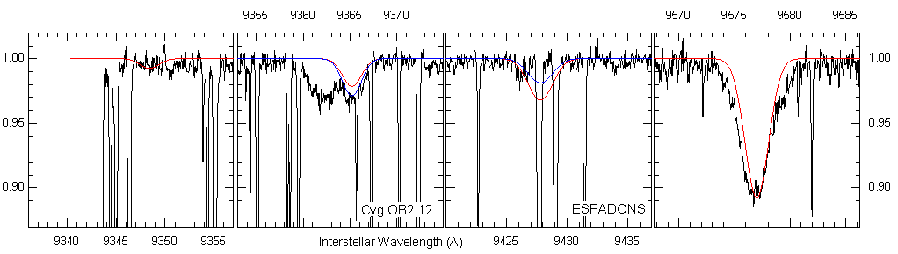
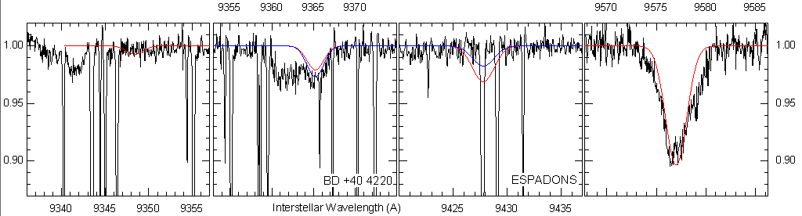

Slide 45
Conclusions
There are no (or poor) correlations with dust & molecules & atomic gas
Poor correlation of 9633 with anything → 9633 is a blend of DIBs ?
9577 correlates with 6196, 6614, broad DIBs
Both DIBs are weak in “zeta” clouds → the effect of low E(B-V) or
UV flux irradiation is needed?

Slide 46
Thank you for attention !

